Slide 1
UNIT-I Analysis of the Recursive and Iterative Algorithms by Dr. N. Subhash Chandra, Professor, CVRCE. Source: Web resources and Computer Algorithms by Horowitz, Sahani & Rajasekaran

Slide 2
CONTENTS
ANALYSIS OF RECURSIVE ALGORITHMS
BRUITE FORCE MEHOD
STORE AND REUSE METHOD
ALGORITHM CORRECTNESS

Slide 3
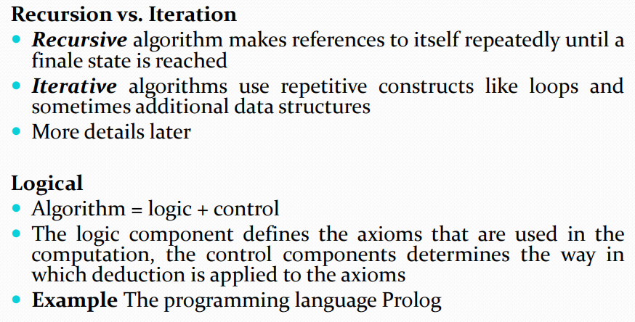
Algorithms

Slide 4
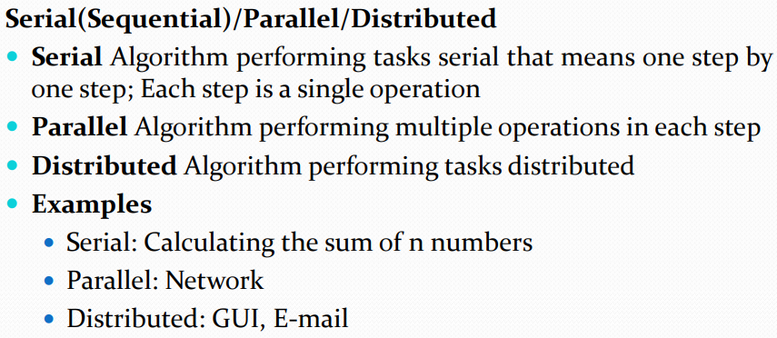
Algorithms

Slide 5
Difference between Recursive and Iterative Algorithms
PROPERTY | RECURSION | ITERATION
Definition | Function calls itself. | A set of instructions repeatedly executed.
Application | For functions. | For loops.
Termination | Through base case, where there will be no function call. | When the termination condition for the iterator ceases to be satisfied.
Usage | Used when code size needs to be small, and time complexity is not an issue. | Used when time complexity needs to be balanced against an expanded code size.
Code Size | Smaller code size | Larger Code Size.
Time Complexity | Very high(generally exponential) time complexity. | Relatively lower time complexity(generally polynomial-logarithmic).

Slide 6
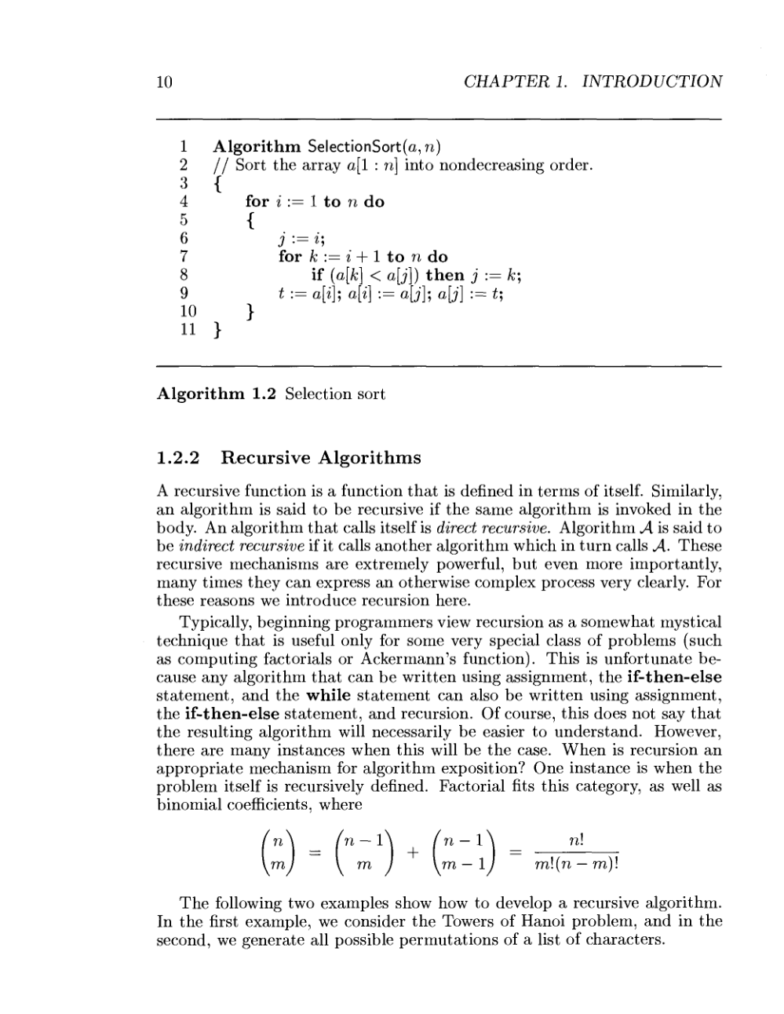
Recursive Algorithms
Ex:
Recursive sum
Factorial
Binary search
Tower of Hanoi
Permutation Generator

Slide 7
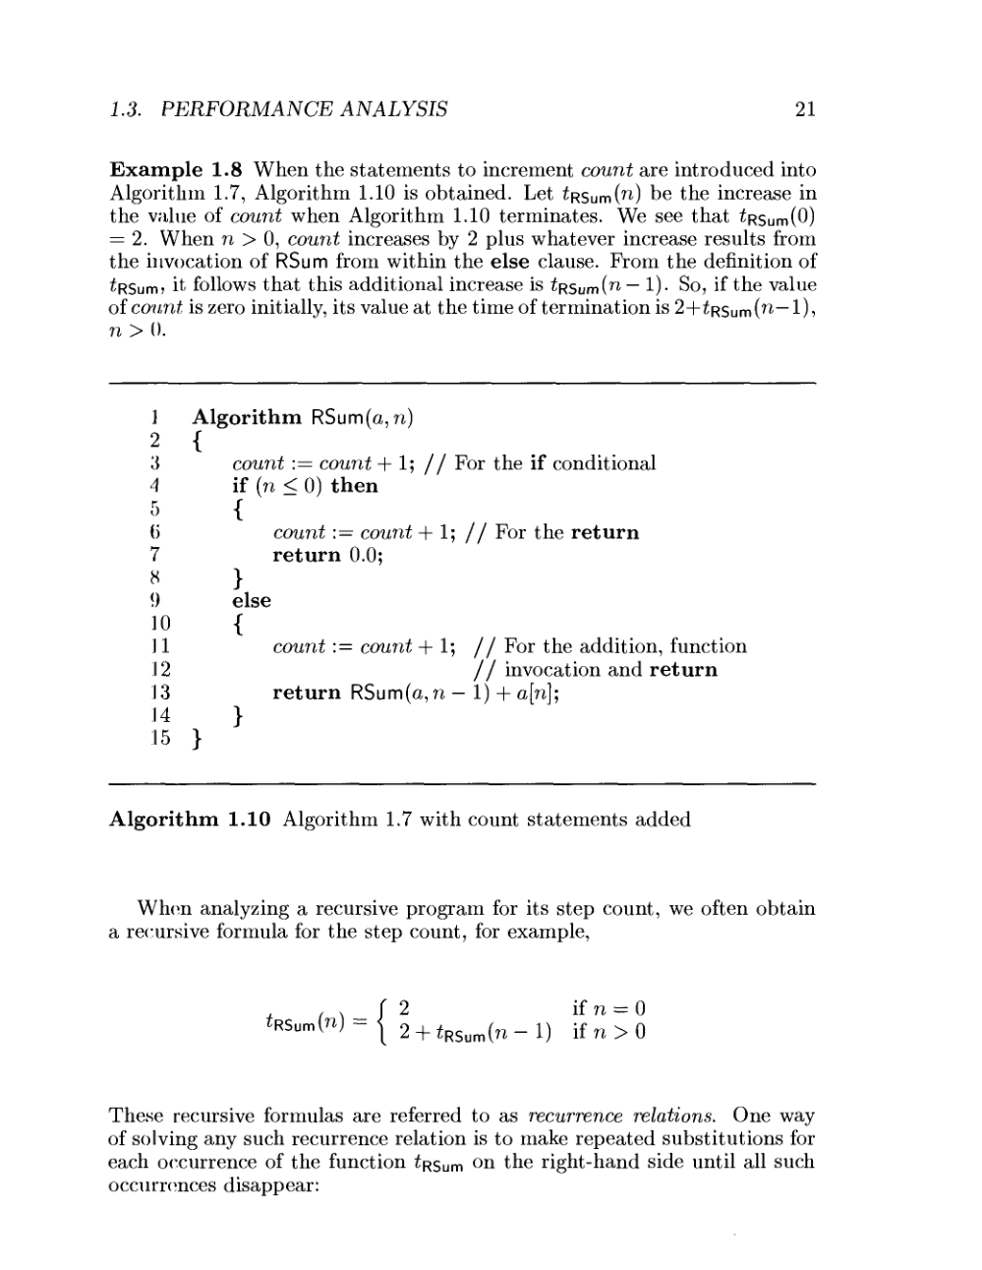
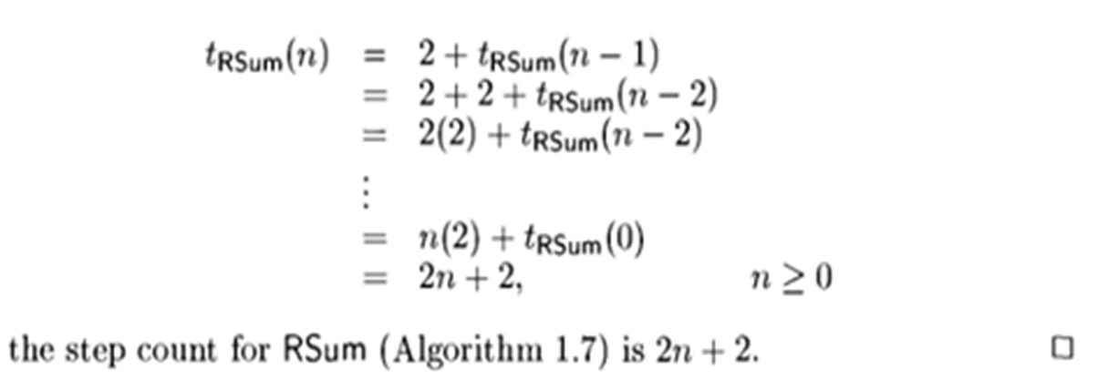
Example: Recursive Sum

Slide 8
Recursive Factorial Algorithm
Form and solve the recurrence relation for the running time of factorial Algorithm and hence determine its big-O complexity:
T(0) = c (1)
T(n) = 1 + T(n - 1) (2)
= 1+ 1 + T(n - 2) by substituting T(n – 1) in (2)
= 1 +1 +1+ T(n - 3) by substituting T(n – 2) in (2)
…
= k + T(n - k)
The base case is reached when n – k = 0 → k = n, we then have:
T(n) = n + T(n - n)
= n + T(0)
= n + c
Therefore the method factorial is O(n)
Algorithm factorial ( n) {
if (n == 0) then
return 1;
else
return n * factorial (n – 1);
}

Slide 9
Recursive Binary Search
The recurrence relation for the running time of the method is:
T(1) = a if n = 1 (one element array)
T(n) = T(n / 2) + b if n > 1
Algorithm BinarySearch (target,array, low, high) {
if (low > high)then
return ;
else {
middle = (low + high)/2;
if (array[middle] == target)then
return middle;
else if(array[middle] < target)then
return BinarySearch(target, array, middle + 1, high);
else
return BinarySearch(target, array, low, middle - 1);
}
}

Slide 10
Analysis of Recursive Binary Search
Without loss of generality, assume n, the problem size, is a multiple of 2, i.e., n = 2^{k}
Expanding:
T(1) = a (1)
T(n) = T(n / 2) + b (2)
= [T(n / 2²) + b] + b = T (n / 2²) + 2b by substituting T(n/2) in (2)
= [T(n / 2³) + b] + 2b = T(n / 2³) + 3b by substituting T(n/2²) in (2)
= ……..
= T( n / 2^{k}) + kb
The base case is reached when n / 2^{k} = 1 ➔ n = 2^{k} ➔ k = log₂ n, we then
have:
T(n) = T(1) + b log₂ n
= a + b log₂ n
Therefore, Recursive Binary Search is O(log n)

Slide 11
Recursive Fibonacci number Algorithm
Algorithm Fibonacci (n) { // Recursively calculates Fibonacci number
if( n == 1 || n == 2)then
return 1;
else
return Fibonacci(n – 1) + Fibonacci(n – 2);
}
T(n) = c if n = 1 or n = 2 (1)
T(n) = T(n – 1) + T(n – 2) + b if n > 2 (2)
We determine a lower bound on T(n):
Expand : T(n) = T(n - 1) + T(n - 2) + b
≥ T(n - 2) + T(n-2) + b
= 2T(n - 2) + b
= 2[T(n - 3) + T(n - 4) + b] + b by substitute T(n - 2) in (2)
≥ 2[T(n - 4) + T(n - 4) + b] + b
= 2²T(n - 4) + 2b + b
= 2²[T(n - 5) + T(n - 6) + b] + 2b + b by substitute T(n - 4) in (2)
≥ 2³T(n – 6) + (2² + 2¹ + 2⁰)b
. . .
≥ 2^{k}T(n – 2k) + (2^{k-1} + 2^{k-2} + . . . + 2¹ + 2⁰)b
= 2^{k}T(n – 2k) + (2^{k} – 1)b
The base case is reached when n – 2k = 2 → k = (n - 2) / 2
Hence, T(n) ≥ 2 ^{(n – 2) / 2} T(2) + [2 ^{(n - 2) / 2} – 1]b
= (b + c)2 ^{(n – 2) / 2} – b
= [(b + c) / 2]*(2)^{n/2} – b → Récursive Fibonacci is exponentiel

Slide 12
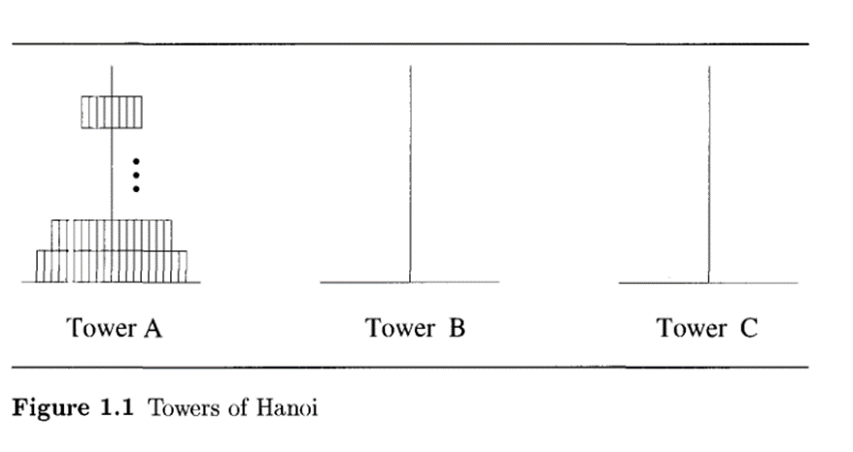
Tower of Hanoi
Tower of Hanoi, is a mathematical puzzle which consists of three towers (pegs) and more than one rings is as depicted
Rules
The mission is to move all the disks to some another tower without violating the sequence of arrangement. A few rules to be followed for Tower of Hanoi are
Only one disk can be moved among the towers at any given time.
Only the "top" disk can be removed.
No large disk can sit over a small disk.

Slide 13
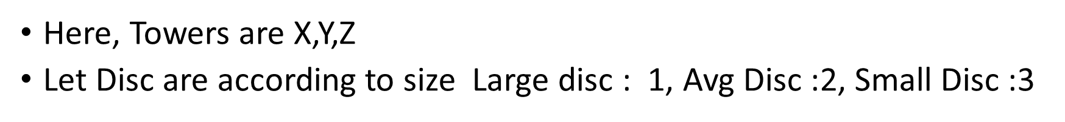
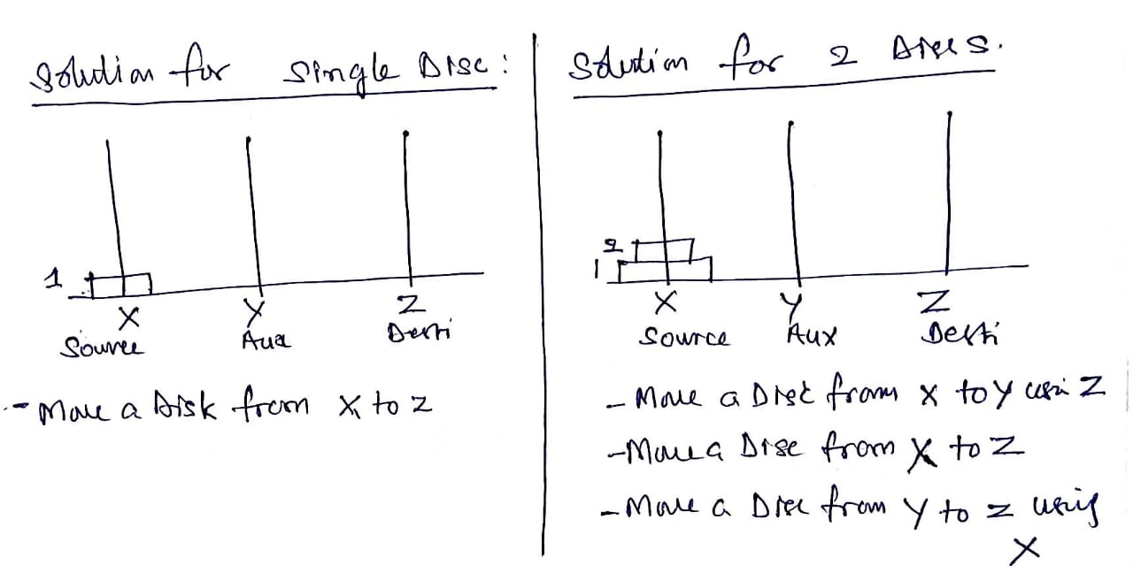
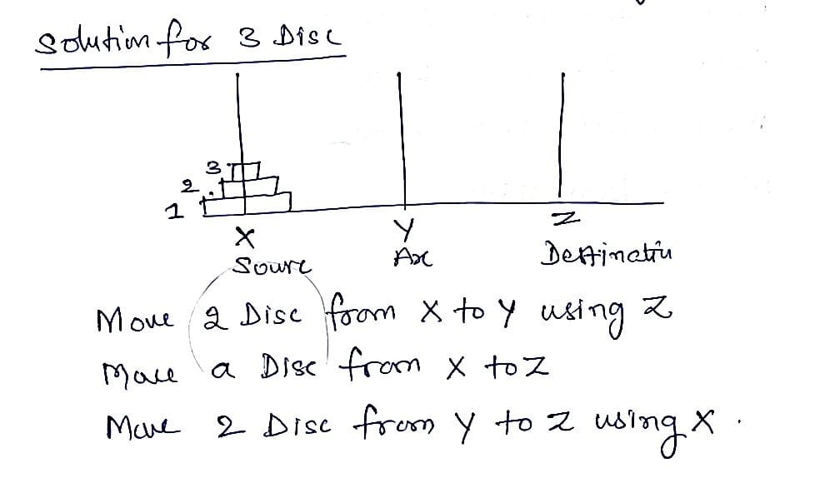
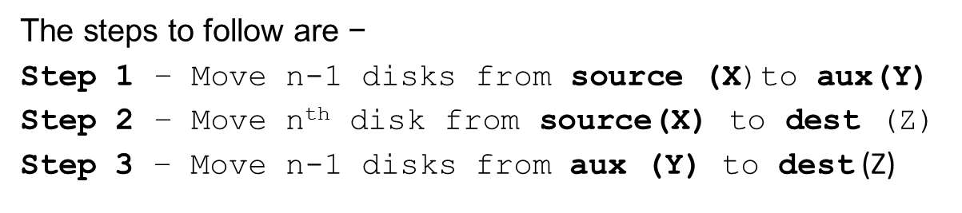
Tower of Hanoi

Slide 14
Algorithm TOH
The steps to follow are −
Step 1 − Move n-1 disks from source (X)to aux(Y)
Step 2 − Move n^{th} disk from source(X) to dest (Z)
Step 3 − Move n-1 disks from aux (Y) to dest (Z)
Algorithm TOH(n, x, y, z)
// Move the top n discs from x to z, where x is source, Y auxiliary tower, Z is destination
{
if(n>=1)then {
TOH(n-1, x, z, y);
write( Move a disc from x to z);
TOH(n-1, y, x, z);
}
}

Slide 15
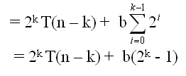
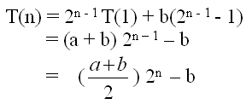
Analysis of Recursive Towers of Hanoi Algorithm
Expanding:
T(1) = a (1)
T(n) = 2T(n – 1) + b if n > 1 (2)
= 2[2T(n – 2) + b] + b = 2² T(n – 2) + 2b + b by substituting T(n – 1) in (2)
= 2² [2T(n – 3) + b] + 2b + b = 2³ T(n – 3) + 2²b + 2b + b by substituting T(n-2) in (2)
= 2³ [2T(n – 4) + b] + 2²b + 2b + b = 2⁴ T(n – 4) + 2³ b + 2²b + 2¹b + 2⁰b by substituting
T(n – 3) in (2)
= ……
= 2^{k} T(n – k) + b[2^{k- 1} + 2^{k– 2} + . . . 2¹ + 2⁰]
The base case is reached when n – k = 1 → k = n – 1, we then have:
Therefore, The complexity is O(2^{n})

Slide 16
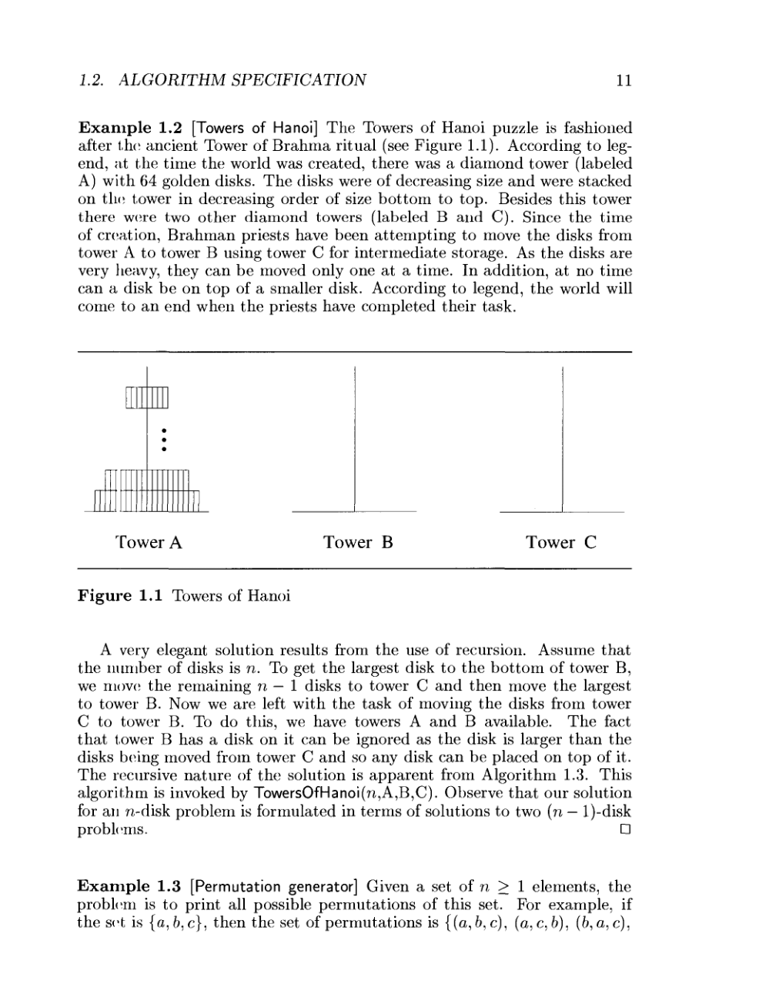
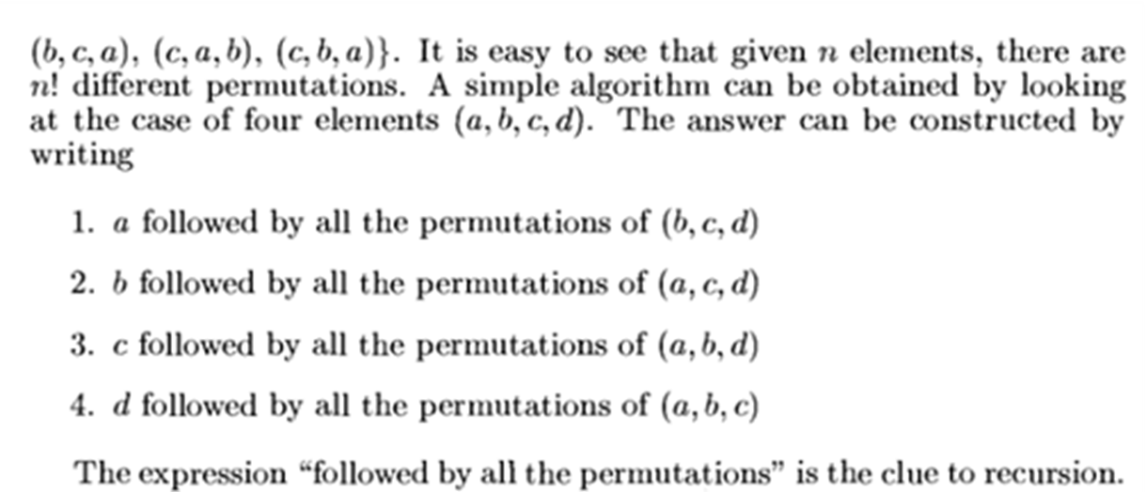
Permutation Generator

Slide 17
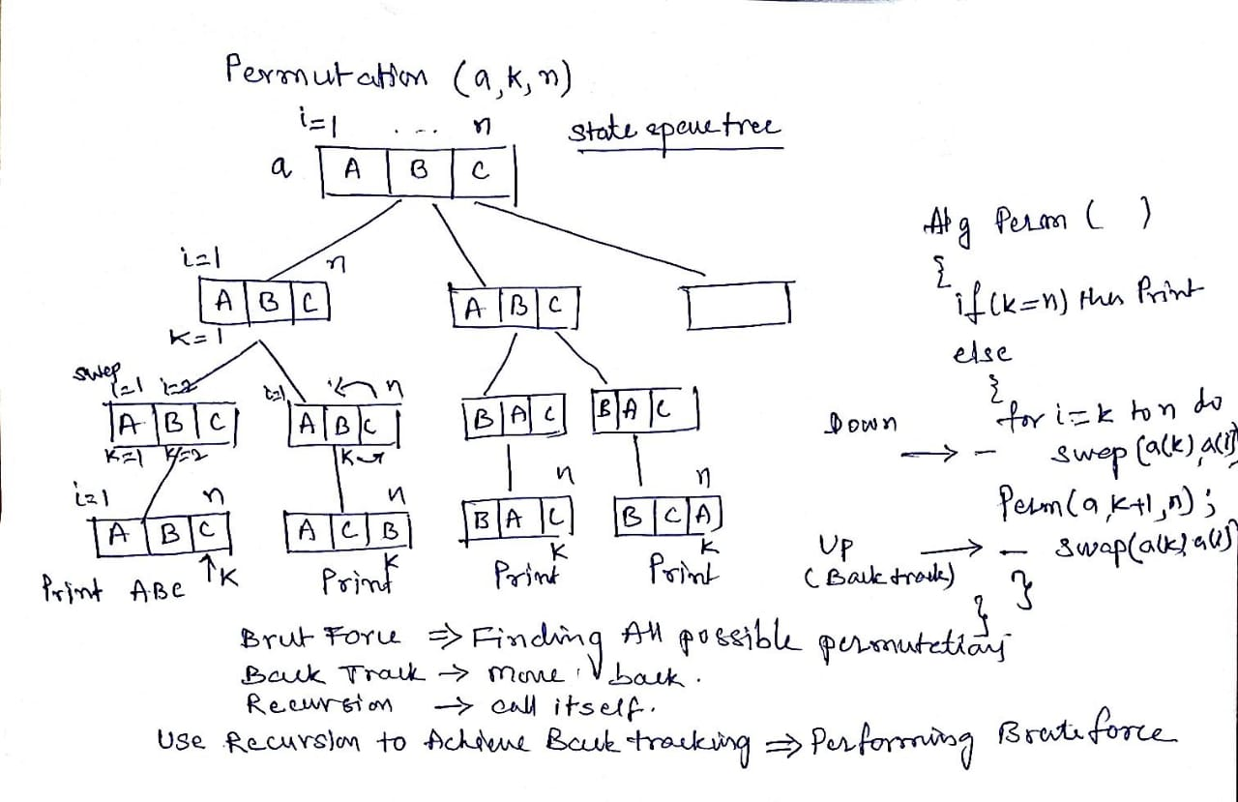
Permutation Generator

Slide 18
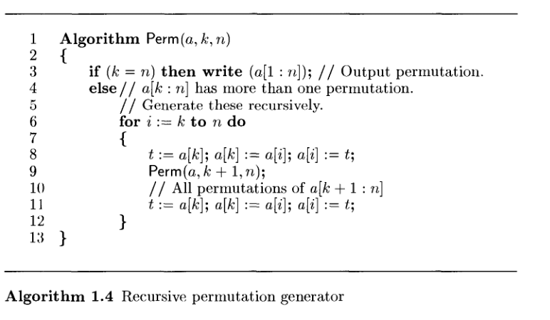
Algorithm for Permutation generator

Slide 19
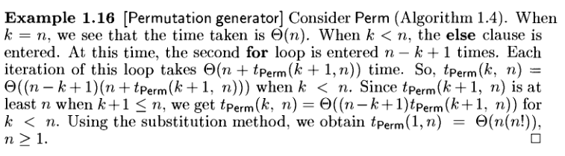
Analysis of Permutation Generator

Slide 20
ANALYSIS OF ITERATIVE ALGORITHMS

Slide 21
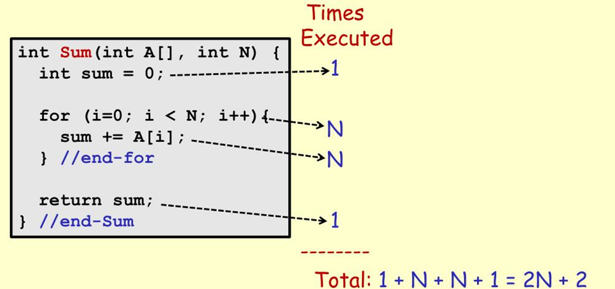
Sum of Elements in array (Iterative Algorithm)

Slide 22
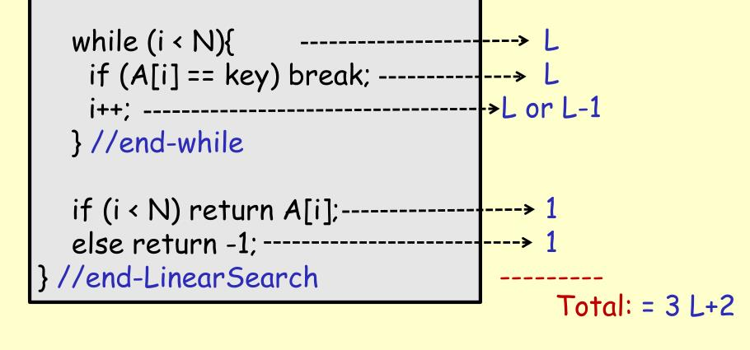
Search an element in array (Iterative Algorithm)

Slide 23
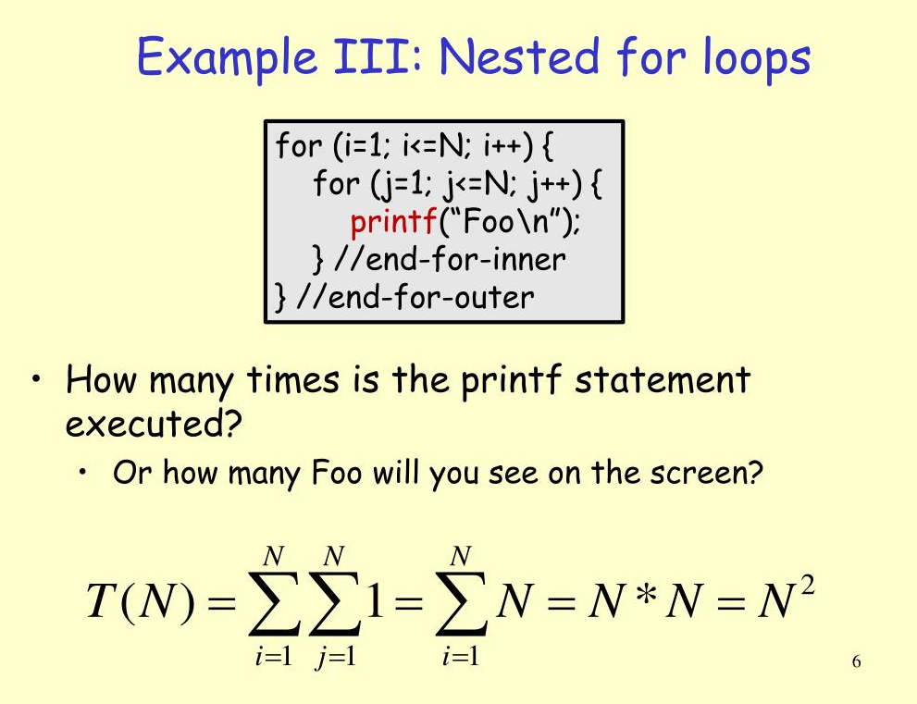

Slide 24
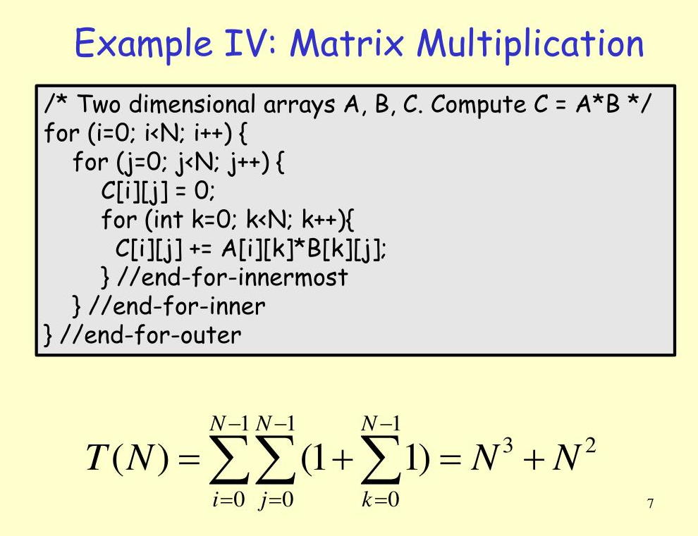

Slide 25
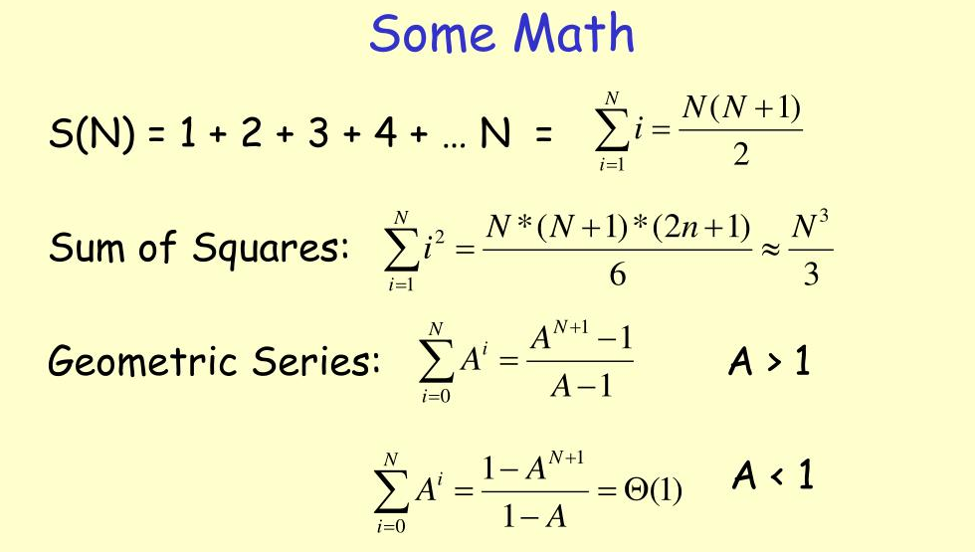

Slide 26
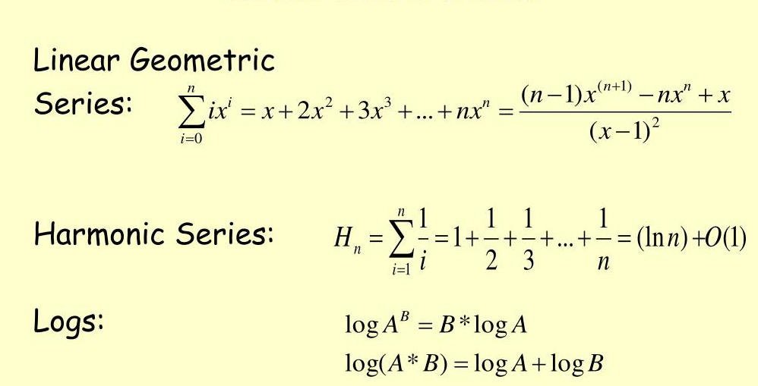

Slide 27
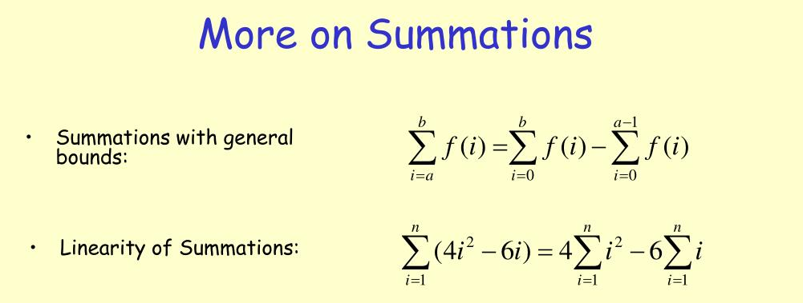

Slide 28
Proving an Algorithm’s Correctness
Brute Force Approach
Store and Reuse Method

Slide 29
Proving an Algorithm’s Correctness
Once an algorithm has been specified then its correctness must be proved. An algorithm must yield a required result for every legitimate input in a finite amount of time.
A common technique for proving correctness is to use mathematical induction because an algorithm’s iterations provide a natural sequence of steps needed for such proofs.
The notion of correctness for approximation algorithms is less straightforward than it is for exact algorithms. The error produced by the algorithm should not exceed a pre-defined limit.

Slide 30
Brute Force Approach
A brute force algorithm is a straightforward approach to solving a problem. It is usually based on problem statement and definitions
This approach consider all possible solutions.
It is based on trial and error where the programmer tries to merely utilize the computer’s fast processing power to solve a problem.
It is a naive approach adopted by most beginner programmers in the initial stages of solving a problem, however it might not be the most optimal approach, as it might increase both space and time complexity.
Ex: TSP, Convex hull, Knapsack, Graph colouring, Closest distance etc

Slide 31
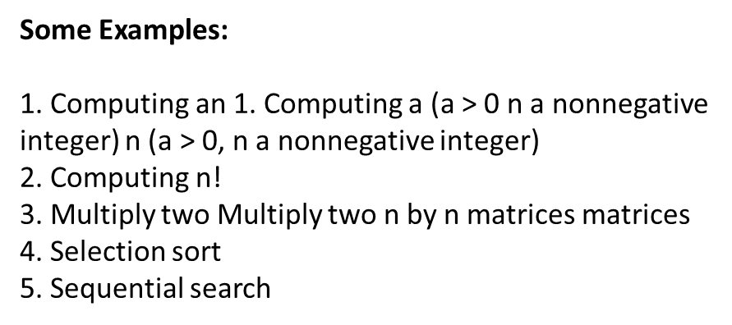
Example 1
Linear Search: When each element of an array is compared with the data to be searched, it might be termed as a brute force approach, as it is the most direct and simple way one could think of searching the given data in the array.
However, there are better ways to search data which make use of more optimum algorithms like Binary search, etc. which adopt a more innovative way to solve the same problem.

Slide 32
Brute Force Solution
Algorithm FindKey()
{
for i:=0 to 9 do {
for j:=0 to 9 do{
for k:=0 to 9 do {
for l:=0 to 9 do{
key:=char(i)+char(j)+char(k)+char(l); // character concatenation operations
if iskey(key) then return key;
}
}
}
}
}

Slide 33
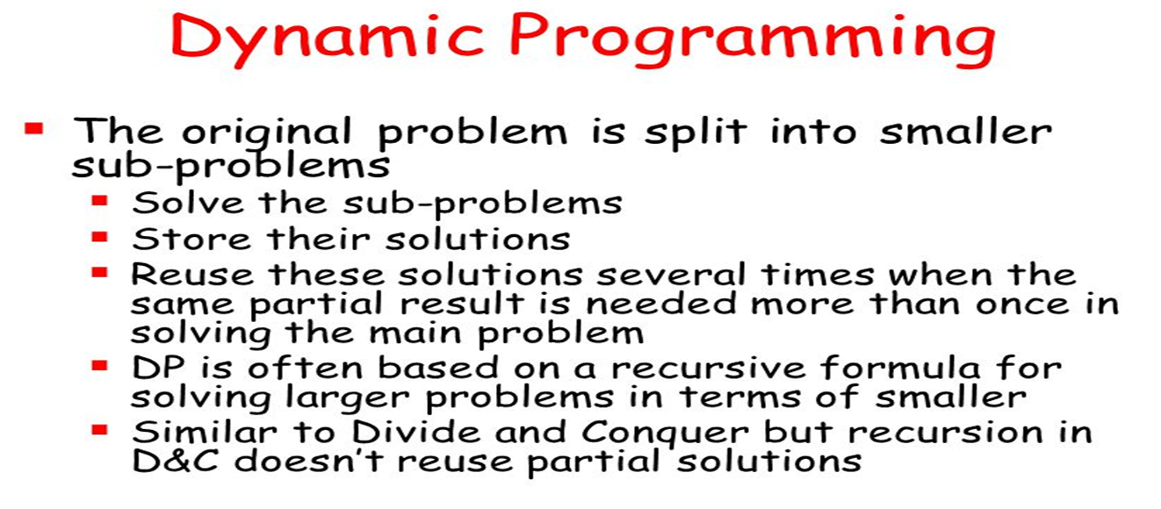
Store and Reuse method:
In this algorithm the data is storing using MapReduce method and the algorithm's access the data through MapReduce method.

Slide 34
Example: Store Method
For example a remote sensing image data save in No-SQL
database can be described as follows:
step 1: Input the entire remote sensing image, the image contains more than one spatial-bands.
step 2: Split the image into sub data according to bands.
Step 3: For each sub data band, split it into lines
Step 4: For each line, the pixels of line construct the value content.
Through this algorithm we can save a remote sensing image into HBase and Hbase deploy on HDFS.

Slide 35
Reuse Method
Content reuse is not one technique, but a collection of many techniques.
There are therefore several reuse algorithms each of which requires specific content structures in the subject and document domains.
The simplest content reuse technique is to cut and paste content from one source to another. This approach is quick and easy to implement, but it creates a host of management problems. So when people talk about content reuse they generally mean any and every means of reusing content other than cutting and pasting.
Reusing content, then, really means storing a piece of content in one place and inserting it into more than one publication by reference. “Reusing” suggests that this activity is somewhat akin to rummaging through that jar of old nuts and bolts we have in the garage looking for one that is the right size to fix our lawnmower.
While we can do it that way, that approach is neither efficient nor reliable. The efficient and reliable approach involves deliberately creating content for use in multiple locations. When we deliberately create content for reuse, we need to place constraints on the content to be reused and the content that reuses it, and that puts we in the realm of structured writing.

